Slide 1


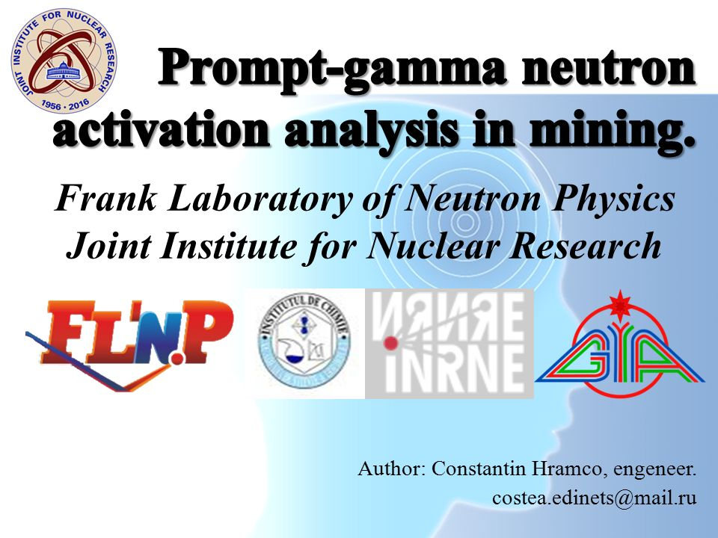
Effect of hydrogen bonding on spectroscopic properties in organic-inorganic hybrids
Magdalena Wachowiak
Supervisor: dr hab. Łukasz Hetmańczyk

Slide 2
Goals
The thermal measurements of three samples belonging do coordination polymers in order to determine the thermal stability (TGA) and to detect the solid-to-solid phase transition (DSC).
The measurement of Raman spectra for the crystals at room temperature, and the comparison with results obtained from infrared spectroscopy.
Theoretical prediction of IR and RS spectra and their comparison with experimental ones.
Some remarks on hydrogen bonds in the measured samples.
Notes:
Charakterystyka spektroskopowa, termiczna, wiązania wodorowe, wiązanie metal - węgiel

Slide 3
Hybrids of organic-inorganic perovskites (HOIPs)
[A]₂B’B”(X)₆
B’ – K⁺
B” – Cr³⁺, Fe³⁺, Co³⁺
X – CN⁻
A – organic cation, acetamidinium

Slide 4
HOIPs

Slide 5
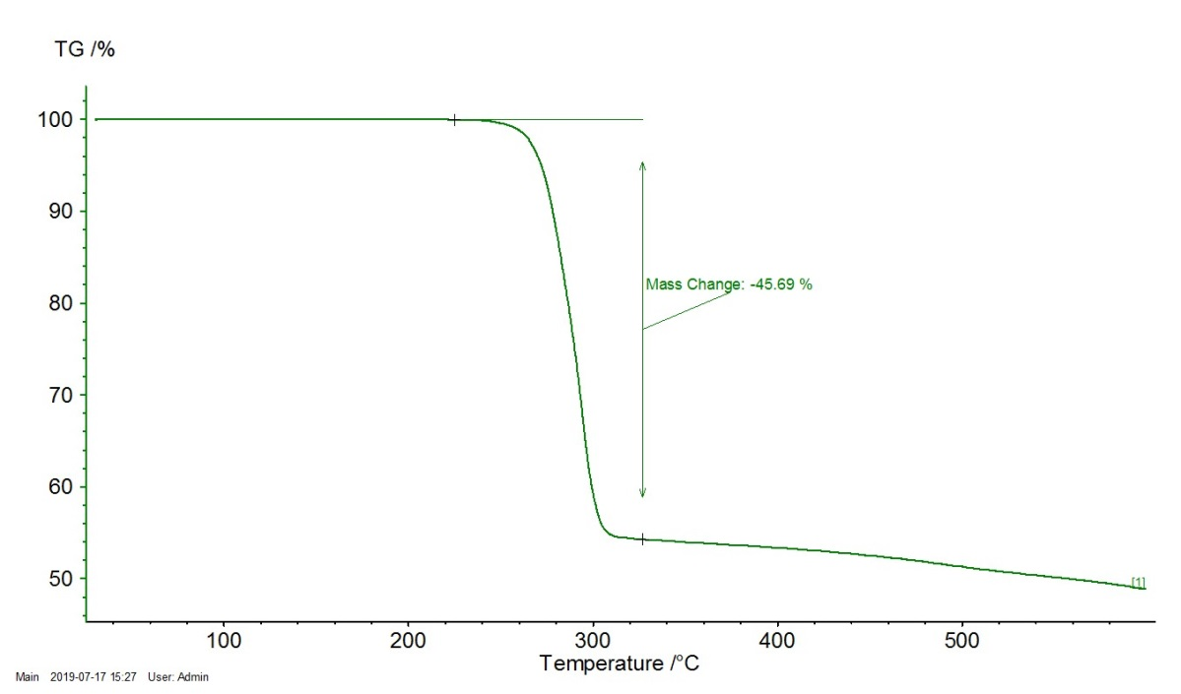
Thermal Gravimetric Analysis, TGA
ACECr
Notes:
Stabilna do 250 st. C

Slide 6
Differential Scanning Calorimetry, DSC
ACECr
ACEFe
ACECo

Slide 7
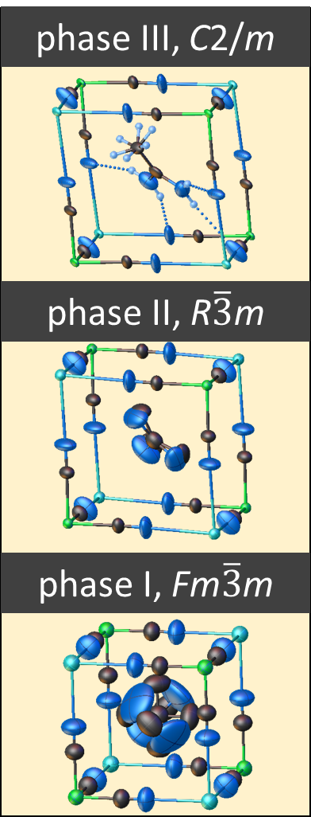
Crystal structure ACECr
low intermediate high

Slide 8
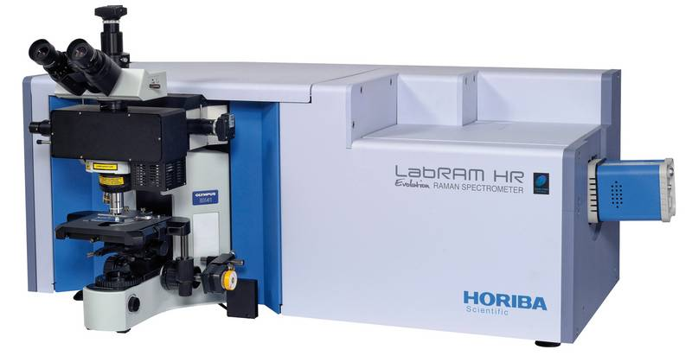
Experimental spectra
Raman spectra:
Horriba LabRam HR Evolution
Dispersive spectrometer
Incident laser wavelength 633 nm
Power: 100% (50% Fe)
Objective: 100x
Wavelength: 50 – 3600 cm⁻¹
Accumulation: 9s
Repetition: 6 times

Slide 9
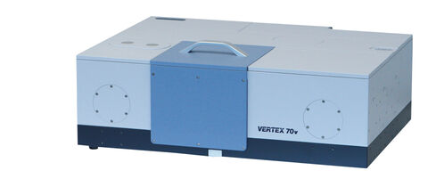
Experimental spectra
IR spectra:
Bruker Vertex 70v
Fourier transform, vacuum
MIR
  range: 400 – 4000 cm⁻¹
  sample suspended in nujol, put on KBr pellet
  32 scans
  KBr beamsplitter
FIR
  range: 30 – 600 cm⁻¹
  sample suspended in apiezon, put on PE disc
  32 scans
  Si beamsplitter

Slide 10
Optical spectra calculation
What for?
To support interpretation of experimental spectra.
The best way: calculation for crystal (solid state) using Periodic Boundary Conditions → phonons.
But …
The systems under investigation are dynamically disordered (even at low temperatures)
Calculations are time consuming → we were time limited.
The spectra were calculated as a sum of constituting molecules:
→ MIR spectra (internal vibrations) are reasonably well reproduced (despite the simplicity of the assumed model),
→ FIR (especially low wavenumber region); lattice vibrations are missing.

Slide 11
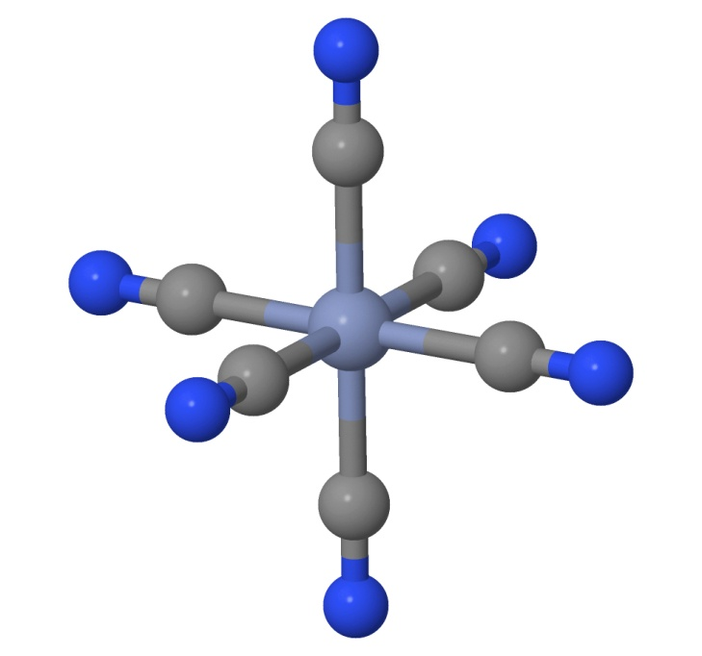
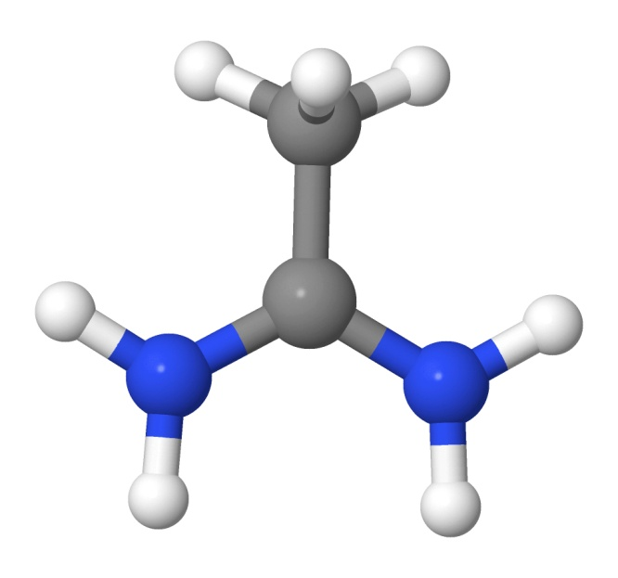

IR and RS spectroscopy
Building blocks
All complexes in the CN⁻ octahedral field
are low spin states:
Cr³⁺ = [Ar]3d³ (2S+1 = 4)
Fe³⁺ = [Ar]3d⁵ (2S+1 = 2)
Co³⁺ = [Ar]3d⁶ (2S+1 = 1)
+
Symmetry: O_{h} (48 symmetry elements)
Γ_{vib}: 2A_{1g} + 2E_{g} + T_{1g} + 2T_{2g} + 4T_{1u} + 2T_{2u}
IR active: 4T_{1u}
RS active: 2A_{1g} + 2E_{g} + 2T_{2g}
Symmetry: C_{s} (only one plane)
Γ_{vib}: 15A’ + 12A”
IR active: 15A’ + 12A”
RS active: 15A’ + 12A”
Method: DFT
Functional: Genaral Ggradient Approximation, PBE + D3BJ dispersion correction (Grimme)
Basis set: TZVPP
Program: ORCA v. 4.1.1
Notes:
The total spectrum was approximated by a sum of spectra calculated for particular isolated molecules

Slide 12
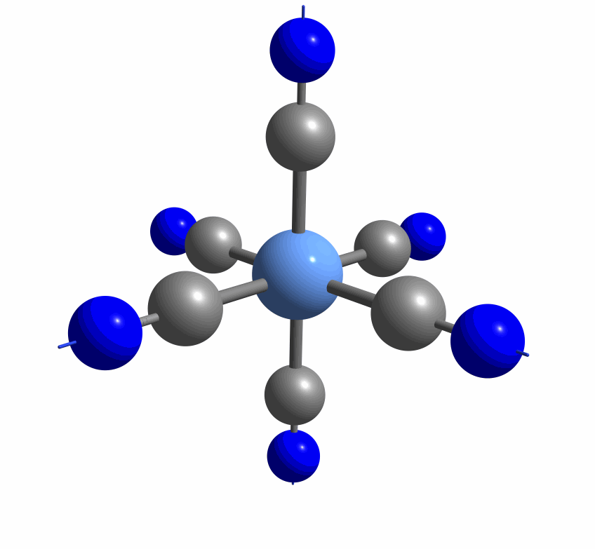
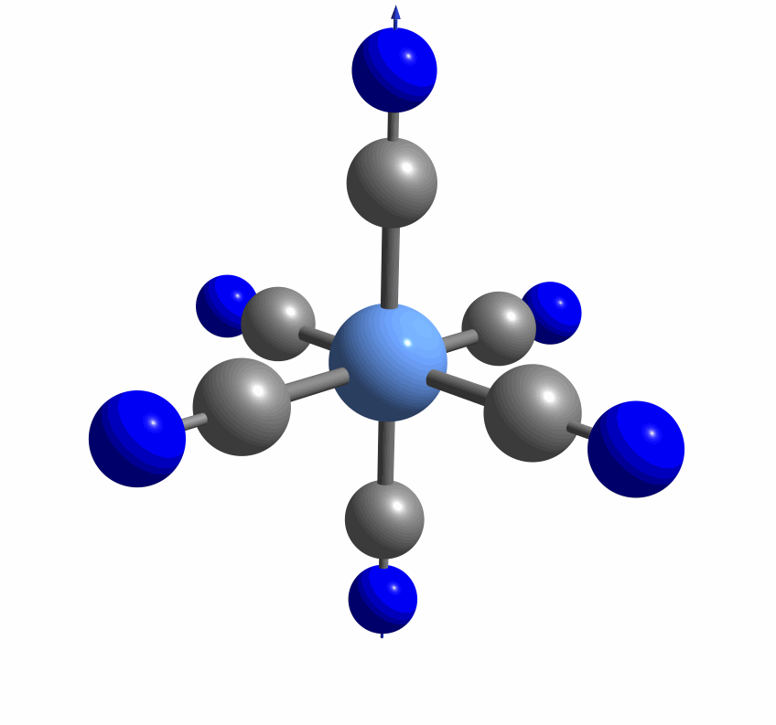
Spectroscopic analysis- ACECo
νC-N
Notes:
Raman, IR

Slide 13
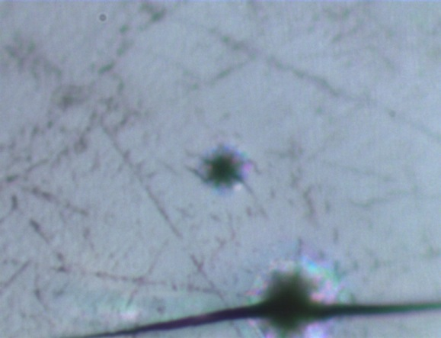
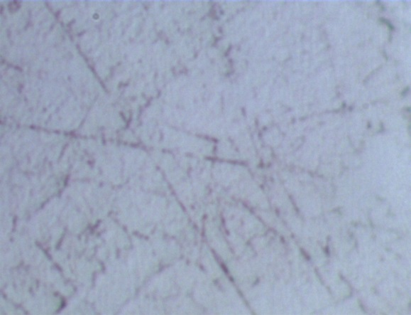
ACEFe
Notes:
Drgania w ramanie i IR

Slide 14
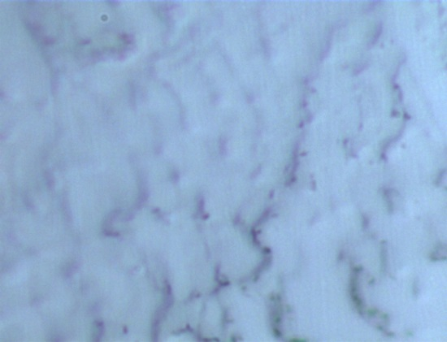
ACECr

Slide 15
Hydrogen bond
angle N-H…N = 150°
~2.5 Å
~3.5 Å

Slide 16
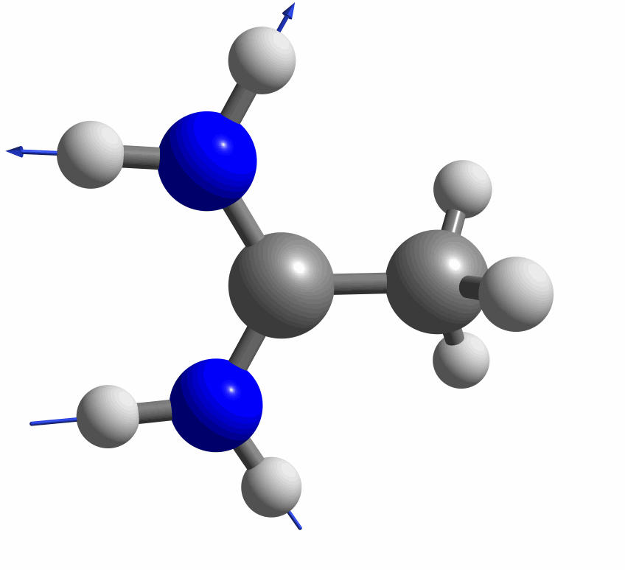

Hydrogen bonding
Notes:
Drgania 2X: symetryczne nie w fazie, asymetryczne

Slide 17
Conclusions
The investigated compounds have two solid-solid phase transitions in the temperature range from -150°C to 150°C.
The samples are thermally stable up to ~220°C.
The calculated IR and RS spectra are in a good agreement with experimental.
Hydrogen bonds are rather weak and are of similar strength in discussed complex. In high temperature phases the organic cation is strongly dynamically disordered.

Slide 18
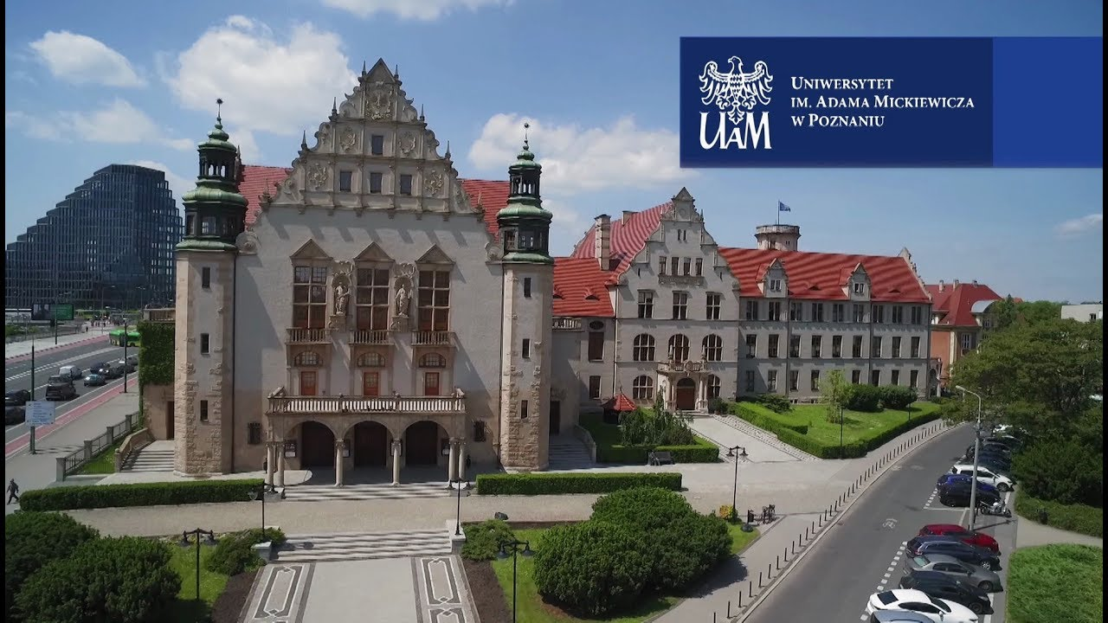
Thank you…..

